Slide 1
A meta-presentation:
Tools for building trustworthy cumulative knowledge
James G. Field, Ph.D.
“First Friday” Research Presentation
I/O Psychology Department | Virginia Tech
February 28, 2020
**These PowerPoint slides and other resources on meta-analysis can be found at:
https://jamiefield.github.io/research/vt2020
John Chambers College of Business and Economics

Slide 2
Personal note
I thank Frank Bosco, Mike McDaniel, Ernest O’Boyle, George Banks, Sven Kepes, Fred Oswald, and Iain Chalmers for the use of some of their slides and/or software.
John Chambers College of Business and Economics

Slide 3
Personal note
I thank Frank Bosco, Mike McDaniel, Ernest O’Boyle, George Banks, Sven Kepes, Fred Oswald, and Iain Chalmers for the use of some of their slides and/or software.
I also thank Molly et al. for organizing this event.
John Chambers College of Business and Economics

Slide 4
Personal note
I thank Frank Bosco, Mike McDaniel, Ernest O’Boyle, George Banks, Sven Kepes, Fred Oswald, and Iain Chalmers for the use of some of their slides and/or software.
I also thank Molly et al. for organizing this event.
I also also thank Charles for being Charles!
John Chambers College of Business and Economics

Slide 5

Agenda
What is meta-analysis and why is it so important?
How to conduct a meta-analysis.
The current research environment and threats to our cumulative knowledge.
Two free tools that will help you with your meta-analysis.
Past and ongoing research efforts.
Open discussion and Q&A.
John Chambers College of Business and Economics

Slide 6
What is a meta-analysis?
Meta-analysis is a statistical technique by which information from independent studies is assimilated (Field, 2011)
Effectively, meta-analysis uses statistical procedures to determine the best estimate (i.e., a fancy weighted average) of the population effect size (McDaniel, 2014)
Meta-analysis examines whether or not the effect is uniform, or varies
In the event that the effect varies across studies, meta-analytic procedures assist the researcher in determining the sources of variation
John Chambers College of Business and Economics

Slide 7
Why are meta-analyses so important?
They are the primary way to summarize, integrate, and synthesize areas of research (Schmidt & Hunter, 2015)
Allows fields to build cumulative scientific knowledge (Kepes & McDaniel, 2015)
Meta-analytic results have been referred to as the “building blocks of theory” (Schmidt, 1992)
Meta-analytic results serve as input for other analytic techniques
Relative importance analysis (see Banks et al., 2015)
Meta-analytic structural equation modeling (see Bennett et al., 2018)
John Chambers College of Business and Economics

Slide 8
Why are meta-analyses so important?
They are the primary way to summarize, integrate, and synthesize areas of research (Schmidt & Hunter, 2015)
Allows fields to build cumulative scientific knowledge (Kepes & McDaniel, 2015)
Meta-analytic results have been referred to as the “building blocks of theory” (Schmidt, 1992)
Meta-analytic results serve as input for other analytic techniques
Relative importance analysis (see Banks et al., 2015)
Meta-analytic structural equation modeling (see Bennett et al., 2018)
“There are research syntheses in such diverse topics as advertising, agriculture, archaeology, astronomy, biology, chemistry, criminology, ecology, education, entomology, law, manufacturing, parapsychology, psychology, public policy, zoology and even of eyewitness accounts of the Indian rope trick.” (italics added for emphasis; Petticrew, BMJ 2001)
John Chambers College of Business and Economics

Slide 9
Why are meta-analyses so important?
They are the primary way to summarize, integrate, and synthesize areas of research (Schmidt & Hunter, 2015)
Allows fields to build cumulative scientific knowledge (Kepes & McDaniel, 2015)
Meta-analytic results have been referred to as the “building blocks of theory” (Schmidt, 1992)
Meta-analytic results serve as input for other analytic techniques
Relative importance analysis (see Banks et al., 2015)
Meta-analytic structural equation modeling (see Bennett et al., 2018)
John Chambers College of Business and Economics

Slide 10
Why are meta-analyses so important?
They are the primary way to summarize, integrate, and synthesize areas of research (Schmidt & Hunter, 2015)
Allows fields to build cumulative scientific knowledge (Kepes & McDaniel, 2015)
Meta-analytic results have been referred to as the “building blocks of theory” (Schmidt, 1992)
Meta-analytic results serve as input for other analytic techniques
Relative importance analysis (see Banks et al., 2015)
Meta-analytic structural equation modeling (see Bennett et al., 2018)
John Chambers College of Business and Economics

Slide 11
Why are meta-analyses so important?
Meta-analytic results often are used to inform evidence-based practice decision (across most industries)
Utility analyses (see Hancock et al., 2012; Kepes & McDaniel, 2015)
John Chambers College of Business and Economics

Slide 12
Why are meta-analyses so important?
Consequences of not taking research synthesis seriously…
John Chambers College of Business and Economics

Slide 13
Why are meta-analyses so important?
Consequences of not taking research synthesis seriously…
The theory
Patients with arrhythmias are at increased risk of early death following a heart attack
John Chambers College of Business and Economics

Slide 14
Why are meta-analyses so important?
Consequences of not taking research synthesis seriously…
The theory
Patients with arrhythmias are at increased risk of early death following a heart attack
Anti-arrhythmic drugs reduce arrhythmias after heart attack
John Chambers College of Business and Economics

Slide 15
Why are meta-analyses so important?
Consequences of not taking research synthesis seriously…
The theory
Patients with arrhythmias are at increased risk of early death following a heart attack
Anti-arrhythmic drugs reduce arrhythmias after heart attack
These drugs should reduce early death after heart attack
John Chambers College of Business and Economics

Slide 16
Why are meta-analyses so important?
Consequences of not taking research synthesis seriously…
The evidence
A 1983 systematic review of 14 RCTs of anti-arrhythmic drugs in heart attack revealed…
“The theoretical potential for a preventive or prophylactic effect of antiarrhythmic drugs….. in the treatment of coronary patients with ventricular arrhythmias has not been realized.” (Furberg, 1983)
John Chambers College of Business and Economics

Slide 17
Why are meta-analyses so important?
Consequences of not taking research synthesis seriously…
The evidence (even more!)
A 1993 systematic review of 51 RCTs of anti-arrhythmic drugs in heart attack revealed (Teo et al., 1993) revealed…
- 660 deaths among 11,712 patients allocated drugs
- 571 deaths among 11,517 patients allocated to control
John Chambers College of Business and Economics

Slide 18
Why are meta-analyses so important?
Consequences of not taking research synthesis seriously…
The consequence
At the peak of their use in the late 1980s, it has been estimated that, on an annual basis, anti-arrhythmic drugs were causing comparable numbers of deaths to the total number of Americans who died in the Vietnam war (Moore 1995)
John Chambers College of Business and Economics

Slide 19
Why are meta-analyses so important?
Consequences of not taking research synthesis seriously…
How could this have been avoided?
The discovery that these drugs are lethal could have been made a decade earlier if the Discussion sections in each report of a new trial had set the new results in the context of a systematic review of the results of all previous trials – in other words, if scientists had cumulated evidence scientifically.
John Chambers College of Business and Economics

Slide 20
Another personal note…
John Chambers College of Business and Economics

Slide 21
Another personal note…
Lord Rayleigh, 1884
“The work which deserves, but I am afraid does not always receive, the most credit is that in which discovery and explanation go hand in hand, in which not only are new facts presented, but their relation to old ones is pointed out.”
Luc de Clapiers Vauvenarques, 1715-1747
“It is easier to say something new than to reconcile things that have already been said.”
John Chambers College of Business and Economics

Slide 22
How to conduct a meta-analysis
Does anyone in the room know how to conduct a meta-analysis?
John Chambers College of Business and Economics

Slide 23
How to conduct a meta-analysis
Cooper’s (2016) seven stages of a meta-analysis (book available here)
Step 1: Problem formulation
Step 2: Searching the literature
Step 3: Gathering information from studies
Step 4: Evaluating the quality of studies
Step 5: Analyzing and integrating the outcomes of studies
Step 6: Interpreting the evidence
Step 7: Presenting the results
John Chambers College of Business and Economics

Slide 24
How to conduct a meta-analysis
Step 1
Step 2
Step 3
Step 4
Step 5
Step 6
Step 7
Step 1: Problem formulation
A clearly defined, explicit question will help you to…
Collect studies
Check which studies should be included
Conduct the analysis
Interpret the results
Advice: Consider pre-registering your meta-analysis (see
John Chambers College of Business and Economics

Slide 25
How to conduct a meta-analysis
Step 1
Step 2
Step 3
Step 4
Step 5
Step 6
Step 7
Step 1: Problem formulation
A clearly defined, explicit question will help you to…
Collect studies
Check which studies should be included
Conduct the analysis
Interpret the results
Advice: Consider pre-registering your meta-analysis (see https://cos.io/prereg/)
John Chambers College of Business and Economics

Slide 26
How to conduct a meta-analysis
Step 1
Step 2
Step 3
Step 4
Step 5
Step 6
Step 7
Step 2: Searching the literature
Predefine inclusion and exclusion criteria based on problem formulation (i.e., Step 1)
Search comprehensively (all domains; related terms no language restrictions; published and unpublished literature; up-to-date)
Document the search!
John Chambers College of Business and Economics

Slide 27
How to conduct a meta-analysis
Step 1
Step 2
Step 3
Step 4
Step 5
Step 6
Step 7
Step 2: Searching the literature (Be transparent: Bad example)
“We conducted a search of the OCB literature by using a number of online databases (e.g., Web of Science, PsycINFO) as well as by examining the reference lists of previous reviews.” (Hoffman et al. 2007)
John Chambers College of Business and Economics

Slide 28
How to conduct a meta-analysis
Step 1
Step 2
Step 3
Step 4
Step 5
Step 6
Step 7
Step 2: Searching the literature (Be transparent: Good example)
We began with an automated search of PsycINFO (Psychological Abstracts) and ABI/Inform using the key words compensation satisfaction, pay satisfaction, compensation equity, pay equity, compensation fairness, and pay fairness. We also searched manually 12 journals for the years 1960 through 2003: Academy of Management Journal, Administrative Science Quarterly, Human Relations, Industrial and Labor Relations Review, Industrial Relations, Journal of Applied Psychology, Journal of Management, Journal of Organizational Behavior, Journal of Occupational and Organizational Psychology, Journal of Vocational Behavior, Organizational Behavior and Human Decision Processes, and Personnel Psychology. (Williams et al., 2006)
John Chambers College of Business and Economics

Slide 29
How to conduct a meta-analysis
Step 1
Step 2
Step 3
Step 4
Step 5
Step 6
Step 7
Step 2: Searching the literature (Be transparent: Good example [cont.])
We chose the year 1960 to begin this search because the first formal attempts to measure pay satisfaction (e.g., the JDI; Smith et al., 1969) and the first theories of pay satisfaction (e.g., Lawler, 1971) were developed in the 1960s and early 1970s, and we were unaware of any empirical work on pay level satisfaction before that time. We also examined the empirical studies that included pay level satisfaction for references to other publications or articles that might have included pay level satisfaction (Williams et al., 2006)
Link to PRISMA flow diagram
John Chambers College of Business and Economics

Slide 30
How to conduct a meta-analysis
Step 1
Step 2
Step 3
Step 4
Step 5
Step 6
Step 7
Steps 3 & 4: Gathering information from studies and evaluating the quality of studies
Also referred to as the dreaded coding stage!
John Chambers College of Business and Economics

Slide 31
How to conduct a meta-analysis
Step 1
Step 2
Step 3
Step 4
Step 5
Step 6
Step 7
A sample data coding form
Study ID | Sample ID | Time | DOI | Title | Pub year | X | Y | N | r | ryy | rxx
1 | 1 | 1 | doi.org/xxx | Article title | 2005 | Job satisfaction | Turnover intention | 356 | .21 | .89 | .93
2 | 1 | 1 | doi.org/xxx | Article title | 2012 | Job satisfaction | Intent to quit | 415 | .18 | .85 | .90
2 | 1 | 2 | doi.org/xxx | Article title | 2012 | Job satisfaction | Intent to quit | 415 | .15 | .87 | .89
3 | 1 | 1 | doi.org/xxx | Article title | 1995 | Job dissatisfaction | Withdrawal cognitions | 264 | -.19 | .81 | .89
3 | 2 | 1 | doi.org/xxx | Article title | 1995 | Job dissatisfaction | Withdrawal cognitions | 189 | .24 | .83 | .79
John Chambers College of Business and Economics

Slide 32
How to conduct a meta-analysis
Step 1
Step 2
Step 3
Step 4
Step 5
Step 6
Step 7
A sample data coding form
Study ID | Sample ID | Time | DOI | Title | Pub year | X | Y | N | r | ryy | rxx
1 | 1 | 1 | doi.org/xxx | Article title | 2005 | Job satisfaction | Turnover intention | 356 | .21 | .89 | .93
2 | 1 | 1 | doi.org/xxx | Article title | 2012 | Job satisfaction | Intent to quit | 415 | .18 | .85 | .90
2 | 1 | 2 | doi.org/xxx | Article title | 2012 | Job satisfaction | Intent to quit | 415 | .15 | .87 | .89
3 | 1 | 1 | doi.org/xxx | Article title | 1995 | Job dissatisfaction | Withdrawal cognitions | 264 | -.19 | .81 | .89
3 | 2 | 1 | doi.org/xxx | Article title | 1995 | Job dissatisfaction | Withdrawal cognitions | 189 | .24 | .83 | .79
John Chambers College of Business and Economics

Slide 33
How to conduct a meta-analysis
Step 1
Step 2
Step 3
Step 4
Step 5
Step 6
Step 7
A sample data coding form
It is good practice to have multiple coders so that inter-rater agreement can be checked!!
Study ID | Sample ID | Time | DOI | Title | Pub year | X | Y | N | r | ryy | rxx
1 | 1 | 1 | doi.org/xxx | Article title | 2005 | Job satisfaction | Turnover intention | 356 | .21 | .89 | .93
2 | 1 | 1 | doi.org/xxx | Article title | 2012 | Job satisfaction | Intent to quit | 415 | .18 | .85 | .90
2 | 1 | 2 | doi.org/xxx | Article title | 2012 | Job satisfaction | Intent to quit | 415 | .15 | .87 | .89
3 | 1 | 1 | doi.org/xxx | Article title | 1995 | Job dissatisfaction | Withdrawal cognitions | 264 | -.19 | .81 | .89
3 | 2 | 1 | doi.org/xxx | Article title | 1995 | Job dissatisfaction | Withdrawal cognitions | 189 | .24 | .83 | .79
John Chambers College of Business and Economics

Slide 34
How to conduct a meta-analysis
Step 1
Step 2
Step 3
Step 4
Step 5
Step 6
Step 7
Your data coding form should also include theoretically- and methodologically-relevant moderators
Sample type
Sample location
Gender
What are some other examples?
John Chambers College of Business and Economics

Slide 35
How to conduct a meta-analysis
Step 1
Step 2
Step 3
Step 4
Step 5
Step 6
Step 7
Step 5: Analyzing and integrating the outcomes of studies
Approaches to meta-analysis
Hunter and Schmidt |  | Hedges and Olkin
Random effects |  | Random and fixed effects
Common in organizational sciences |  | Common in other social and medical sciences
Can correct for sampling, measurement error, and range restriction |  | Corrects for sampling error only
John Chambers College of Business and Economics

Slide 36
How to conduct a meta-analysis
Step 1
Step 2
Step 3
Step 4
Step 5
Step 6
Step 7
Step 5: Analyzing and integrating the outcomes of studies
Approaches to meta-analysis
Hunter and Schmidt |  | Hedges and Olkin
Random effects |  | Random and fixed effects
Common in organizational sciences |  | Common in other social and medical sciences
Can correct for sampling, measurement error, and range restriction |  | Corrects for sampling error only
John Chambers College of Business and Economics

Slide 37
How to conduct a meta-analysis
Step 1
Step 2
Step 3
Step 4
Step 5
Step 6
Step 7
Step 5: Analyzing and integrating the outcomes of studies
What actually goes on under the hood? Let’s take a quick look…
John Chambers College of Business and Economics

Slide 38
Hunter & Schmidt approach
Coding sheet
N | r | ryy | rxx | z
356 | .21 | .89 | .93 | 0.213171347
415 | .18 | .85 | .90 | 0.181982689
415 | .15 | .87 | .89 | 0.151140436
264 | .19 | .81 | .89 | 0.192337169
189 | .24 | .83 | .79 | 0.244774113
How to conduct a meta-analysis
John Chambers College of Business and Economics
Step 1
Step 2
Step 3
Step 4
Step 5
Step 6
Step 7
Step 5: Analyzing and integrating the outcomes of studies

Slide 39
Hunter & Schmidt approach
Coding sheet
N | r | ryy | rxx | z
356 | .21 | .89 | .93 | 0.213171347
415 | .18 | .85 | .90 | 0.181982689
415 | .15 | .87 | .89 | 0.151140436
264 | .19 | .81 | .89 | 0.192337169
189 | .24 | .83 | .79 | 0.244774113
How to conduct a meta-analysis
John Chambers College of Business and Economics
Step 1
Step 2
Step 3
Step 4
Step 5
Step 6
Step 7
Step 5: Analyzing and integrating the outcomes of studies

Slide 40
Hunter & Schmidt approach
Coding sheet
N | r | ryy | rxx | z | (N * z)
356 | .21 | .89 | .93 | 0.213171347 | 75.88899938
415 | .18 | .85 | .90 | 0.181982689 | 75.52281577
415 | .15 | .87 | .89 | 0.151140436 | 62.72328091
264 | .19 | .81 | .89 | 0.192337169 | 50.77701267
189 | .24 | .83 | .79 | 0.244774113 | 46.26230729
How to conduct a meta-analysis
John Chambers College of Business and Economics
Step 1
Step 2
Step 3
Step 4
Step 5
Step 6
Step 7
Step 5: Analyzing and integrating the outcomes of studies

Slide 41
Hunter & Schmidt approach
Coding sheet
N | r | ryy | rxx | z | (N * z)
356 | .21 | .89 | .93 | 0.213171347 | 75.88899938
415 | .18 | .85 | .90 | 0.181982689 | 75.52281577
415 | .15 | .87 | .89 | 0.151140436 | 62.72328091
264 | .19 | .81 | .89 | 0.192337169 | 50.77701267
189 | .24 | .83 | .79 | 0.244774113 | 46.26230729
1639 |  |  |  |  | 311.174416
How to conduct a meta-analysis
John Chambers College of Business and Economics
Step 1
Step 2
Step 3
Step 4
Step 5
Step 6
Step 7
Step 5: Analyzing and integrating the outcomes of studies

Slide 42
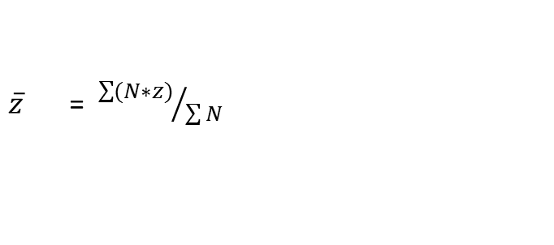
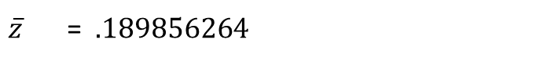
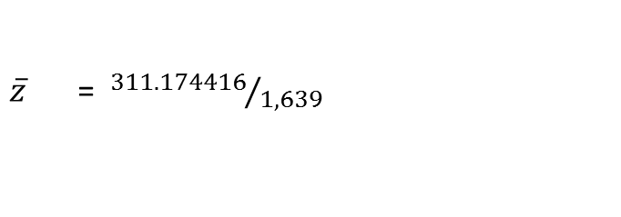
Hunter & Schmidt approach
$\overline{z}$ = ${\sum{(N∗z)}}/{\sum{N}}$
Coding sheet
N | r | ryy | rxx | z | (N * z)
356 | .21 | .89 | .93 | 0.213171347 | 75.88899938
415 | .18 | .85 | .90 | 0.181982689 | 75.52281577
415 | .15 | .87 | .89 | 0.151140436 | 62.72328091
264 | .19 | .81 | .89 | 0.192337169 | 50.77701267
189 | .24 | .83 | .79 | 0.244774113 | 46.26230729
1639 |  |  |  |  | 311.174416
$\overline{z}$ = ${311.174416}/{1,639}$
$\overline{z}$ = $.189856264$
How to conduct a meta-analysis
John Chambers College of Business and Economics
Step 1
Step 2
Step 3
Step 4
Step 5
Step 6
Step 7
Step 5: Analyzing and integrating the outcomes of studies

Slide 43
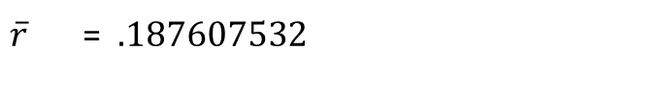
Hunter & Schmidt approach
$\overline{z}$ = ${\sum{(N∗z)}}/{\sum{N}}$
Coding sheet
N | r | ryy | rxx | z | (N * z)
356 | .21 | .89 | .93 | 0.213171347 | 75.88899938
415 | .18 | .85 | .90 | 0.181982689 | 75.52281577
415 | .15 | .87 | .89 | 0.151140436 | 62.72328091
264 | .19 | .81 | .89 | 0.192337169 | 50.77701267
189 | .24 | .83 | .79 | 0.244774113 | 46.26230729
1639 |  |  |  |  | 311.174416
$\overline{z}$ = ${311.174416}/{1,639}$
$\overline{z}$ = $.189856264$
$\overline{r}$ = $.187607532$
How to conduct a meta-analysis
John Chambers College of Business and Economics
Step 1
Step 2
Step 3
Step 4
Step 5
Step 6
Step 7
Step 5: Analyzing and integrating the outcomes of studies

Slide 44
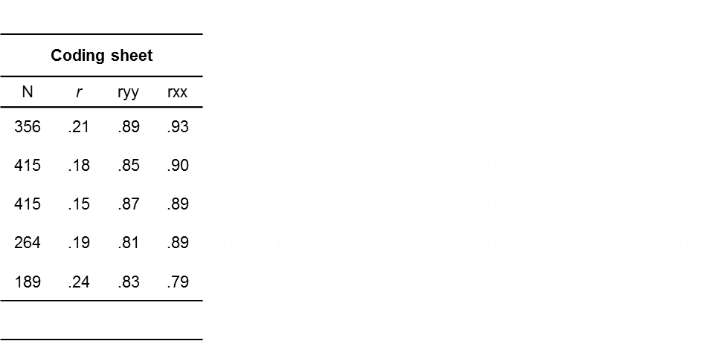
Hedges and Olkin approach
Coding sheet |  |  |  |  | (N - 3) | (1/N – 3) | $$\sqrt{vi}$$ | $$1/{\sqrt{vi}}$$
N | r | ryy | rxx | z | w | vi | sei | inv.sei | z * inv.sei
356 | .21 | .89 | .93 | 0.213171347 | 353 | 0.002833 | 0.053225 | 18.78829 | 4.005126
415 | .18 | .85 | .90 | 0.181982689 | 412 | 0.002427 | 0.049266 | 20.29778 | 3.693845
415 | .15 | .87 | .89 | 0.151140436 | 412 | 0.002427 | 0.049266 | 20.29778 | 3.067816
264 | .19 | .81 | .89 | 0.192337169 | 261 | 0.003831 | 0.061898 | 16.15549 | 3.107302
189 | .24 | .83 | .79 | 0.244774113 | 186 | 0.005376 | 0.073324 | 13.63818 | 3.338274
 |  |  |  |  |  |  |  | 89.17754 | 17.21236
How to conduct a meta-analysis
John Chambers College of Business and Economics
Step 1
Step 2
Step 3
Step 4
Step 5
Step 6
Step 7
Step 5: Analyzing and integrating the outcomes of studies

Slide 45
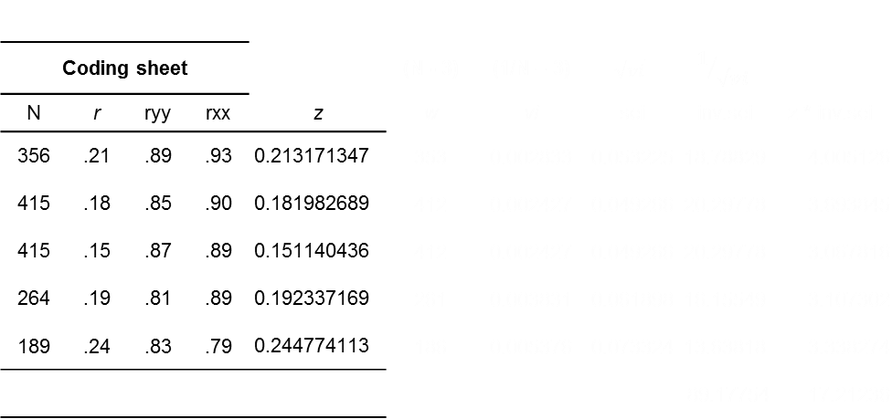
Hedges and Olkin approach
Coding sheet |  |  |  |  | (N - 3) | (1/N – 3) | $$\sqrt{vi}$$ | $$1/{\sqrt{vi}}$$
N | r | ryy | rxx | z | w | vi | sei | inv.sei | z * inv.sei
356 | .21 | .89 | .93 | 0.213171347 | 353 | 0.002833 | 0.053225 | 18.78829 | 4.005126
415 | .18 | .85 | .90 | 0.181982689 | 412 | 0.002427 | 0.049266 | 20.29778 | 3.693845
415 | .15 | .87 | .89 | 0.151140436 | 412 | 0.002427 | 0.049266 | 20.29778 | 3.067816
264 | .19 | .81 | .89 | 0.192337169 | 261 | 0.003831 | 0.061898 | 16.15549 | 3.107302
189 | .24 | .83 | .79 | 0.244774113 | 186 | 0.005376 | 0.073324 | 13.63818 | 3.338274
 |  |  |  |  |  |  |  | 89.17754 | 17.21236
How to conduct a meta-analysis
John Chambers College of Business and Economics
Step 1
Step 2
Step 3
Step 4
Step 5
Step 6
Step 7
Step 5: Analyzing and integrating the outcomes of studies

Slide 46
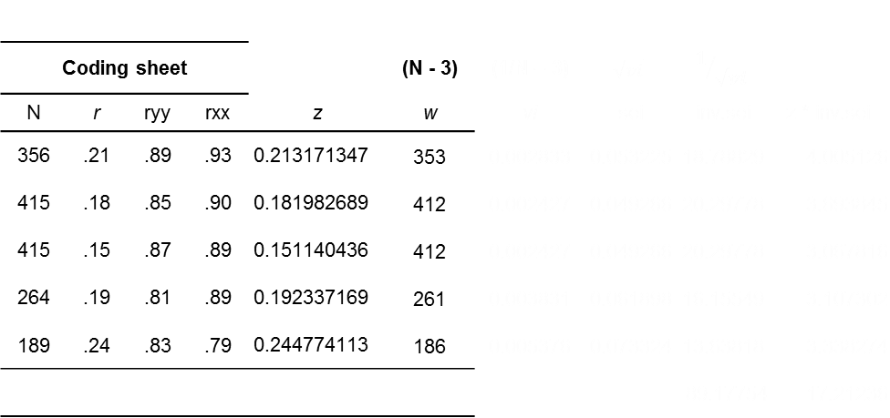
Hedges and Olkin approach
Coding sheet |  |  |  |  | (N - 3) | (1/N – 3) | $$\sqrt{vi}$$ | $$1/{\sqrt{vi}}$$
N | r | ryy | rxx | z | w | vi | sei | inv.sei | z * inv.sei
356 | .21 | .89 | .93 | 0.213171347 | 353 | 0.002833 | 0.053225 | 18.78829 | 4.005126
415 | .18 | .85 | .90 | 0.181982689 | 412 | 0.002427 | 0.049266 | 20.29778 | 3.693845
415 | .15 | .87 | .89 | 0.151140436 | 412 | 0.002427 | 0.049266 | 20.29778 | 3.067816
264 | .19 | .81 | .89 | 0.192337169 | 261 | 0.003831 | 0.061898 | 16.15549 | 3.107302
189 | .24 | .83 | .79 | 0.244774113 | 186 | 0.005376 | 0.073324 | 13.63818 | 3.338274
 |  |  |  |  |  |  |  | 89.17754 | 17.21236
How to conduct a meta-analysis
John Chambers College of Business and Economics
Step 1
Step 2
Step 3
Step 4
Step 5
Step 6
Step 7
Step 5: Analyzing and integrating the outcomes of studies

Slide 47
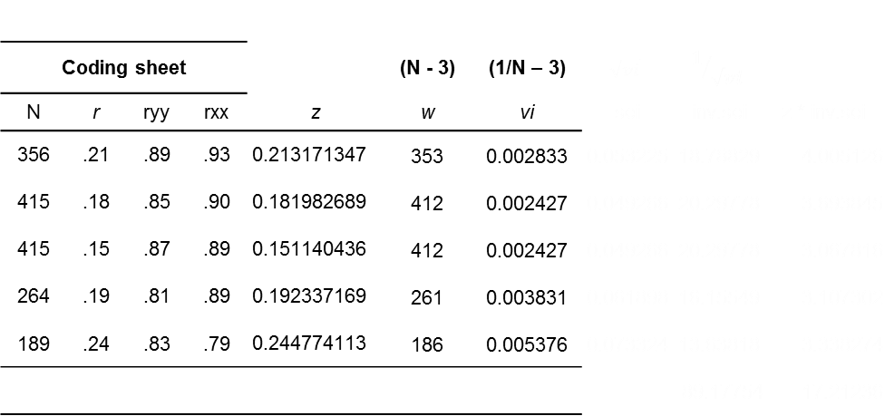
Hedges and Olkin approach
Coding sheet |  |  |  |  | (N - 3) | (1/N – 3) | $$\sqrt{vi}$$ | $$1/{\sqrt{vi}}$$
N | r | ryy | rxx | z | w | vi | sei | inv.sei | z * inv.sei
356 | .21 | .89 | .93 | 0.213171347 | 353 | 0.002833 | 0.053225 | 18.78829 | 4.005126
415 | .18 | .85 | .90 | 0.181982689 | 412 | 0.002427 | 0.049266 | 20.29778 | 3.693845
415 | .15 | .87 | .89 | 0.151140436 | 412 | 0.002427 | 0.049266 | 20.29778 | 3.067816
264 | .19 | .81 | .89 | 0.192337169 | 261 | 0.003831 | 0.061898 | 16.15549 | 3.107302
189 | .24 | .83 | .79 | 0.244774113 | 186 | 0.005376 | 0.073324 | 13.63818 | 3.338274
 |  |  |  |  |  |  |  | 89.17754 | 17.21236
How to conduct a meta-analysis
John Chambers College of Business and Economics
Step 1
Step 2
Step 3
Step 4
Step 5
Step 6
Step 7
Step 5: Analyzing and integrating the outcomes of studies

Slide 48
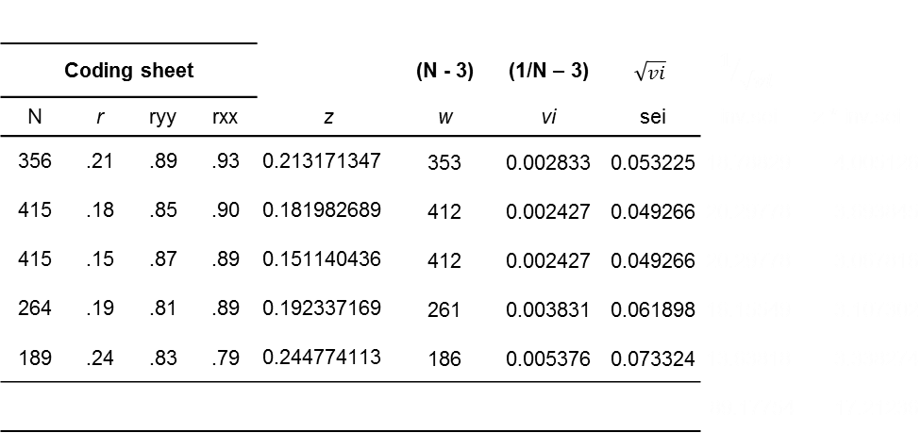
Hedges and Olkin approach
Coding sheet |  |  |  |  | (N - 3) | (1/N – 3) | $$\sqrt{vi}$$ | $$1/{\sqrt{vi}}$$
N | r | ryy | rxx | z | w | vi | sei | inv.sei | z * inv.sei
356 | .21 | .89 | .93 | 0.213171347 | 353 | 0.002833 | 0.053225 | 18.78829 | 4.005126
415 | .18 | .85 | .90 | 0.181982689 | 412 | 0.002427 | 0.049266 | 20.29778 | 3.693845
415 | .15 | .87 | .89 | 0.151140436 | 412 | 0.002427 | 0.049266 | 20.29778 | 3.067816
264 | .19 | .81 | .89 | 0.192337169 | 261 | 0.003831 | 0.061898 | 16.15549 | 3.107302
189 | .24 | .83 | .79 | 0.244774113 | 186 | 0.005376 | 0.073324 | 13.63818 | 3.338274
 |  |  |  |  |  |  |  | 89.17754 | 17.21236
How to conduct a meta-analysis
John Chambers College of Business and Economics
Step 1
Step 2
Step 3
Step 4
Step 5
Step 6
Step 7
Step 5: Analyzing and integrating the outcomes of studies

Slide 49
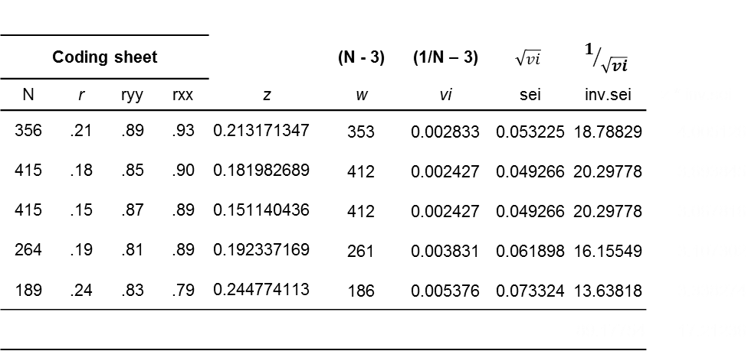
Hedges and Olkin approach
Coding sheet |  |  |  |  | (N - 3) | (1/N – 3) | $$\sqrt{vi}$$ | $$1/{\sqrt{vi}}$$
N | r | ryy | rxx | z | w | vi | sei | inv.sei | z * inv.sei
356 | .21 | .89 | .93 | 0.213171347 | 353 | 0.002833 | 0.053225 | 18.78829 | 4.005126
415 | .18 | .85 | .90 | 0.181982689 | 412 | 0.002427 | 0.049266 | 20.29778 | 3.693845
415 | .15 | .87 | .89 | 0.151140436 | 412 | 0.002427 | 0.049266 | 20.29778 | 3.067816
264 | .19 | .81 | .89 | 0.192337169 | 261 | 0.003831 | 0.061898 | 16.15549 | 3.107302
189 | .24 | .83 | .79 | 0.244774113 | 186 | 0.005376 | 0.073324 | 13.63818 | 3.338274
 |  |  |  |  |  |  |  | 89.17754 | 17.21236
How to conduct a meta-analysis
John Chambers College of Business and Economics
Step 1
Step 2
Step 3
Step 4
Step 5
Step 6
Step 7
Step 5: Analyzing and integrating the outcomes of studies

Slide 50
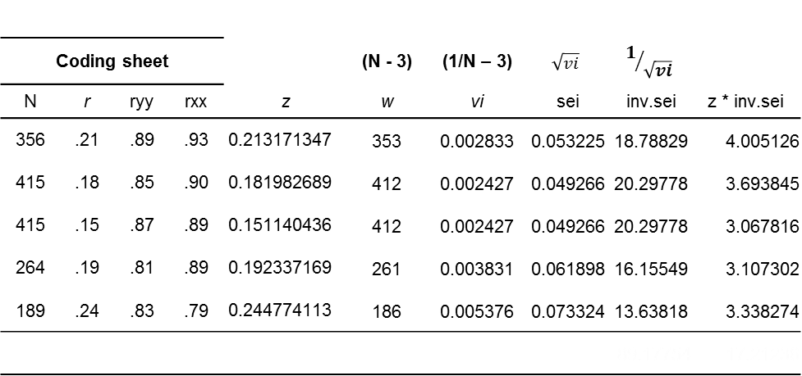
Hedges and Olkin approach
Coding sheet |  |  |  |  | (N - 3) | (1/N – 3) | $$\sqrt{vi}$$ | $$1/{\sqrt{vi}}$$
N | r | ryy | rxx | z | w | vi | sei | inv.sei | z * inv.sei
356 | .21 | .89 | .93 | 0.213171347 | 353 | 0.002833 | 0.053225 | 18.78829 | 4.005126
415 | .18 | .85 | .90 | 0.181982689 | 412 | 0.002427 | 0.049266 | 20.29778 | 3.693845
415 | .15 | .87 | .89 | 0.151140436 | 412 | 0.002427 | 0.049266 | 20.29778 | 3.067816
264 | .19 | .81 | .89 | 0.192337169 | 261 | 0.003831 | 0.061898 | 16.15549 | 3.107302
189 | .24 | .83 | .79 | 0.244774113 | 186 | 0.005376 | 0.073324 | 13.63818 | 3.338274
 |  |  |  |  |  |  |  | 89.17754 | 17.21236
How to conduct a meta-analysis
John Chambers College of Business and Economics
Step 1
Step 2
Step 3
Step 4
Step 5
Step 6
Step 7
Step 5: Analyzing and integrating the outcomes of studies

Slide 51
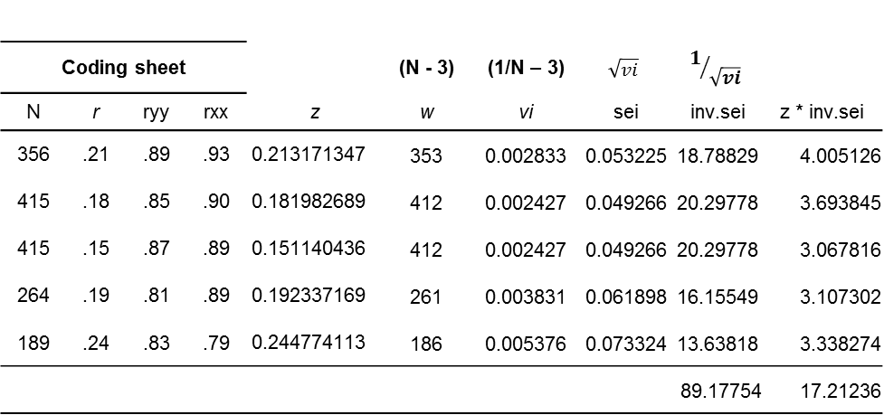
Hedges and Olkin approach
Coding sheet |  |  |  |  | (N - 3) | (1/N – 3) | $$\sqrt{vi}$$ | $$1/{\sqrt{vi}}$$
N | r | ryy | rxx | z | w | vi | sei | inv.sei | z * inv.sei
356 | .21 | .89 | .93 | 0.213171347 | 353 | 0.002833 | 0.053225 | 18.78829 | 4.005126
415 | .18 | .85 | .90 | 0.181982689 | 412 | 0.002427 | 0.049266 | 20.29778 | 3.693845
415 | .15 | .87 | .89 | 0.151140436 | 412 | 0.002427 | 0.049266 | 20.29778 | 3.067816
264 | .19 | .81 | .89 | 0.192337169 | 261 | 0.003831 | 0.061898 | 16.15549 | 3.107302
189 | .24 | .83 | .79 | 0.244774113 | 186 | 0.005376 | 0.073324 | 13.63818 | 3.338274
 |  |  |  |  |  |  |  | 89.17754 | 17.21236
How to conduct a meta-analysis
John Chambers College of Business and Economics
Step 1
Step 2
Step 3
Step 4
Step 5
Step 6
Step 7
Step 5: Analyzing and integrating the outcomes of studies

Slide 52
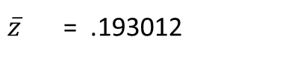
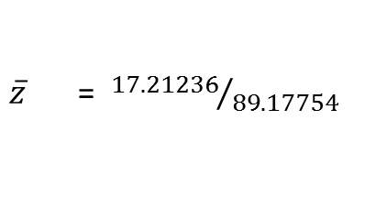
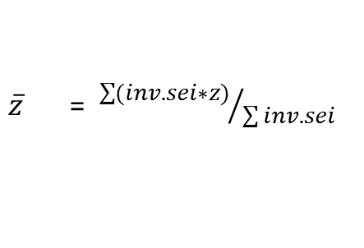
Hedges and Olkin approach
Coding sheet |  |  |  |  | (N - 3) | (1/N – 3) | $$\sqrt{vi}$$ | $$1/{\sqrt{vi}}$$
N | r | ryy | rxx | z | w | vi | sei | inv.sei | z * inv.sei
356 | .21 | .89 | .93 | 0.213171347 | 353 | 0.002833 | 0.053225 | 18.78829 | 4.005126
415 | .18 | .85 | .90 | 0.181982689 | 412 | 0.002427 | 0.049266 | 20.29778 | 3.693845
415 | .15 | .87 | .89 | 0.151140436 | 412 | 0.002427 | 0.049266 | 20.29778 | 3.067816
264 | .19 | .81 | .89 | 0.192337169 | 261 | 0.003831 | 0.061898 | 16.15549 | 3.107302
189 | .24 | .83 | .79 | 0.244774113 | 186 | 0.005376 | 0.073324 | 13.63818 | 3.338274
 |  |  |  |  |  |  |  | 89.17754 | 17.21236
$\overline{z}$ = ${\sum{(inv.sei∗z)}}/{\sum{inv.sei}}$
$\overline{z}$ = ${17.21236}/{89.17754}$
$\overline{z}$ = .193012
How to conduct a meta-analysis
John Chambers College of Business and Economics
Step 1
Step 2
Step 3
Step 4
Step 5
Step 6
Step 7
Step 5: Analyzing and integrating the outcomes of studies

Slide 53
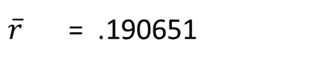
Hedges and Olkin approach
Coding sheet |  |  |  |  | (N - 3) | (1/N – 3) | $$\sqrt{vi}$$ | $$1/{\sqrt{vi}}$$
N | r | ryy | rxx | z | w | vi | sei | inv.sei | z * inv.sei
356 | .21 | .89 | .93 | 0.213171347 | 353 | 0.002833 | 0.053225 | 18.78829 | 4.005126
415 | .18 | .85 | .90 | 0.181982689 | 412 | 0.002427 | 0.049266 | 20.29778 | 3.693845
415 | .15 | .87 | .89 | 0.151140436 | 412 | 0.002427 | 0.049266 | 20.29778 | 3.067816
264 | .19 | .81 | .89 | 0.192337169 | 261 | 0.003831 | 0.061898 | 16.15549 | 3.107302
189 | .24 | .83 | .79 | 0.244774113 | 186 | 0.005376 | 0.073324 | 13.63818 | 3.338274
 |  |  |  |  |  |  |  | 89.17754 | 17.21236
$\overline{z}$ = ${\sum{(inv.sei∗z)}}/{\sum{inv.sei}}$
$\overline{z}$ = ${17.21236}/{89.17754}$
$\overline{z}$ = .193012
$\overline{r}$ = .190651
How to conduct a meta-analysis
John Chambers College of Business and Economics
Step 1
Step 2
Step 3
Step 4
Step 5
Step 6
Step 7
Step 5: Analyzing and integrating the outcomes of studies

Slide 54
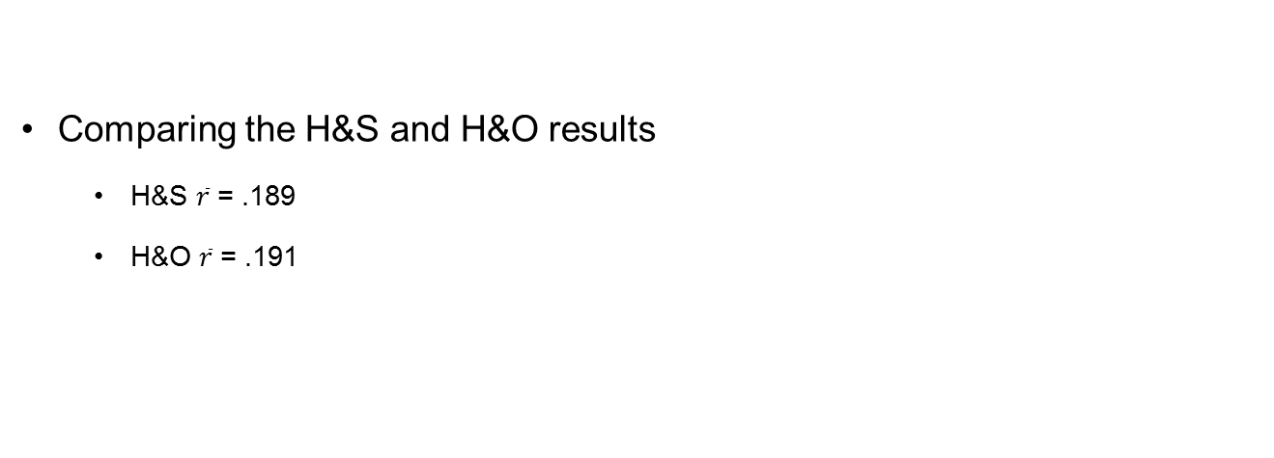
How to conduct a meta-analysis
Step 1
Step 2
Step 3
Step 4
Step 5
Step 6
Step 7
Comparing the H&S and H&O results
H&S $\overline{r}$ = .189
H&O $\overline{r}$ = .191
John Chambers College of Business and Economics

Slide 55
How to conduct a meta-analysis
Step 1
Step 2
Step 3
Step 4
Step 5
Step 6
Step 7
Step 6: Interpreting the evidence
Compare the observed meta-analytic mean effect size to existing effect size benchmarks (see Bosco et al., 2015)
Does the 95% confidence interval include zero?
Do the corresponding sensitivity analysis results suggest that the observed meta-analytic mean effect size estimate is robust?
John Chambers College of Business and Economics

Slide 56
How to conduct a meta-analysis
Step 1
Step 2
Step 3
Step 4
Step 5
Step 6
Step 7
Step 6: Presenting the evidence
Be transparent!
John Chambers College of Business and Economics

Slide 57
Open-source meta-analysis tools
metaBUS
An instant meta-analysis tool
See http://metabus.org/
Meta-Sen
A comprehensive sensitivity analysis tool
See https://metasen.shinyapps.io/gen1/
John Chambers College of Business and Economics

Slide 58
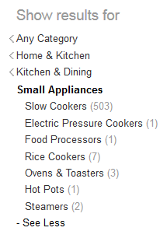
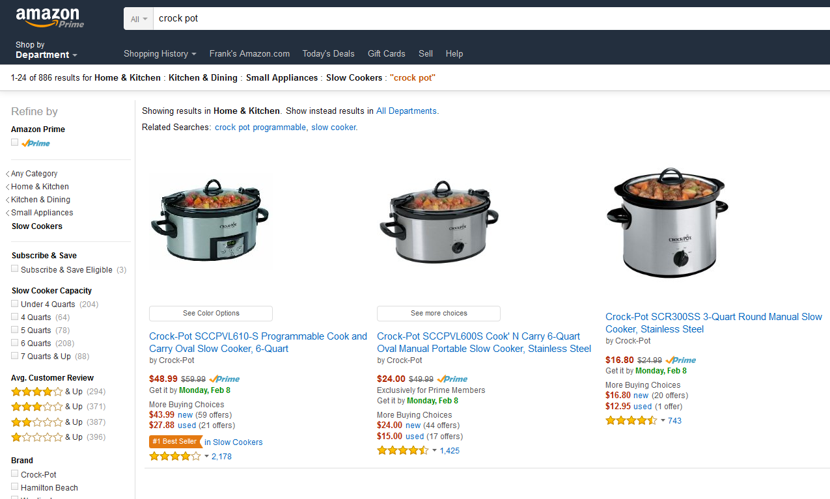
metaBUS
How do we find crockpots?
John Chambers College of Business and Economics

Slide 59





metaBUS
How do we find scientific findings?
John Chambers College of Business and Economics

Slide 60
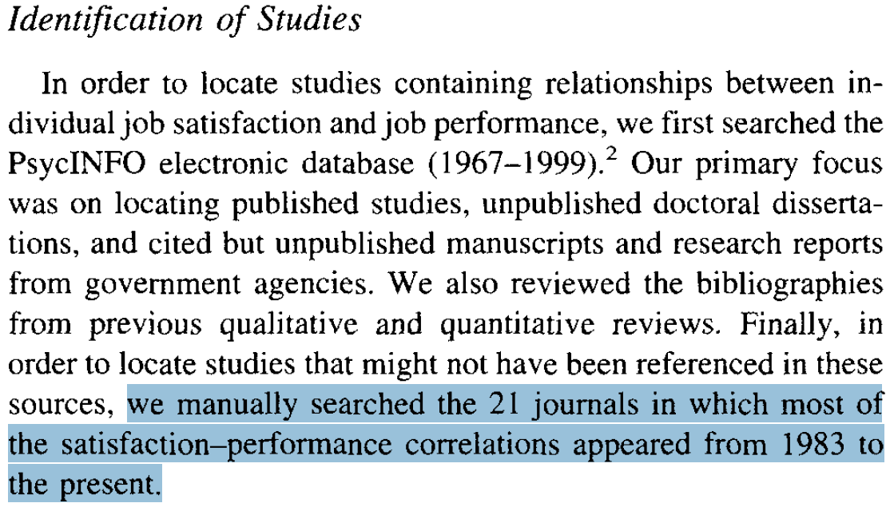
metaBUS
How do we find scientific findings?
John Chambers College of Business and Economics

Slide 61
metaBUS
How do we find scientific findings?
21 journals * 17 years = 357 volumes 357 volumes * 5 issues = 1,785 issues
1,785 issues * 6 articles = 10,710 articles
(Judge et al., 2001; Psychological Bulletin)
John Chambers College of Business and Economics

Slide 62

metaBUS
Science lags behind crockpots!!
$$>$$
John Chambers College of Business and Economics

Slide 63
metaBUS
Database
1,100,000 effect sizes
~30 OB/HR/IO journals
Published between 1980 and 2017
All effect sizes tagged to a hierarchical taxonomic map of the field
Taxonomic map of the field
John Chambers College of Business and Economics

Slide 64
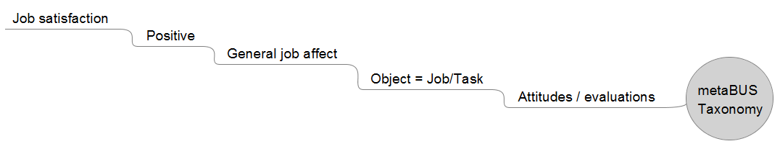
metaBUS
Database
1,100,000 effect sizes
~30 OB/HR/IO journals
Published between 1980 and 2017
All effect sizes tagged to a hierarchical taxonomic map of the field
Taxonomic map of the field
Level 6
Level 1
John Chambers College of Business and Economics

Slide 65
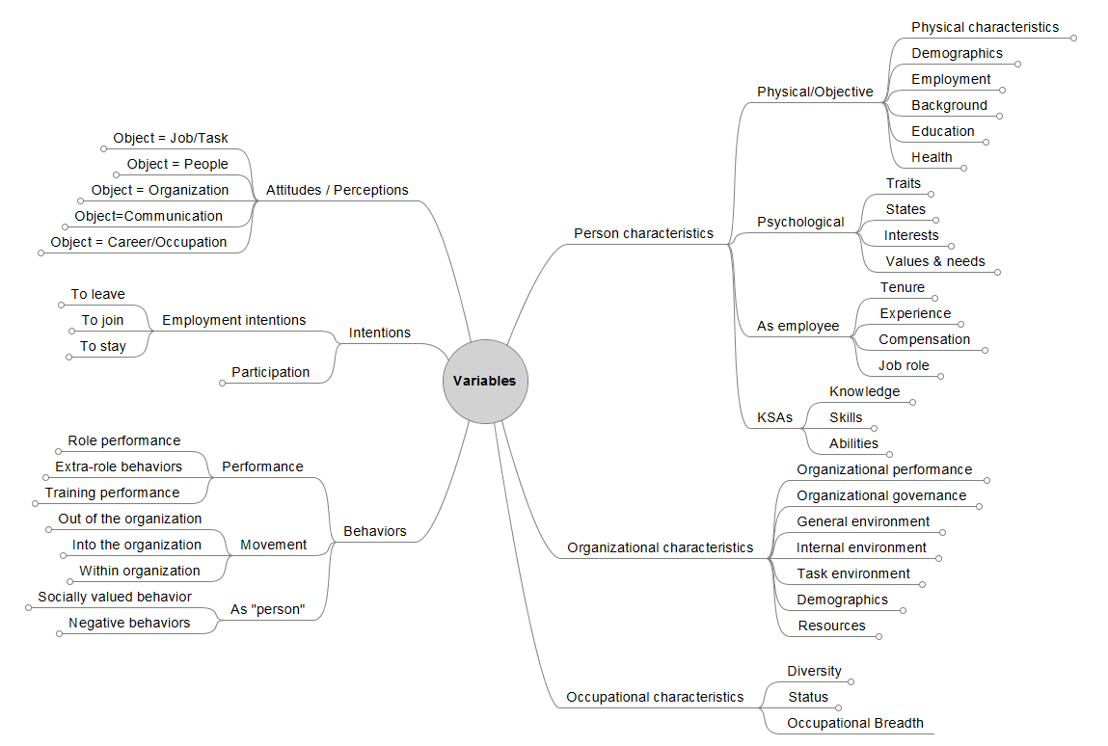
John Chambers College of Business and Economics

Slide 66
Live demonstration
metaBUS
An instant meta-analysis tool
See http://metabus.org/
John Chambers College of Business and Economics

Slide 67
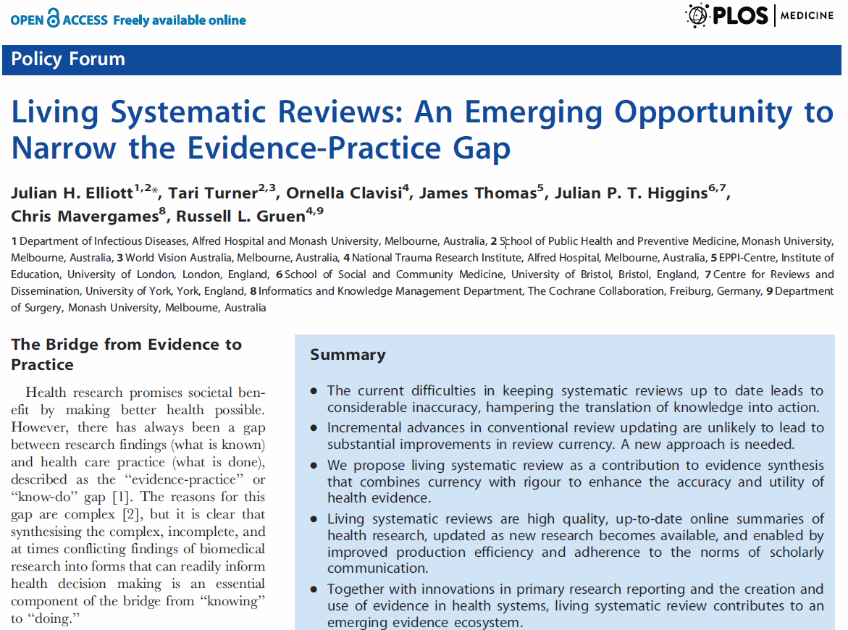
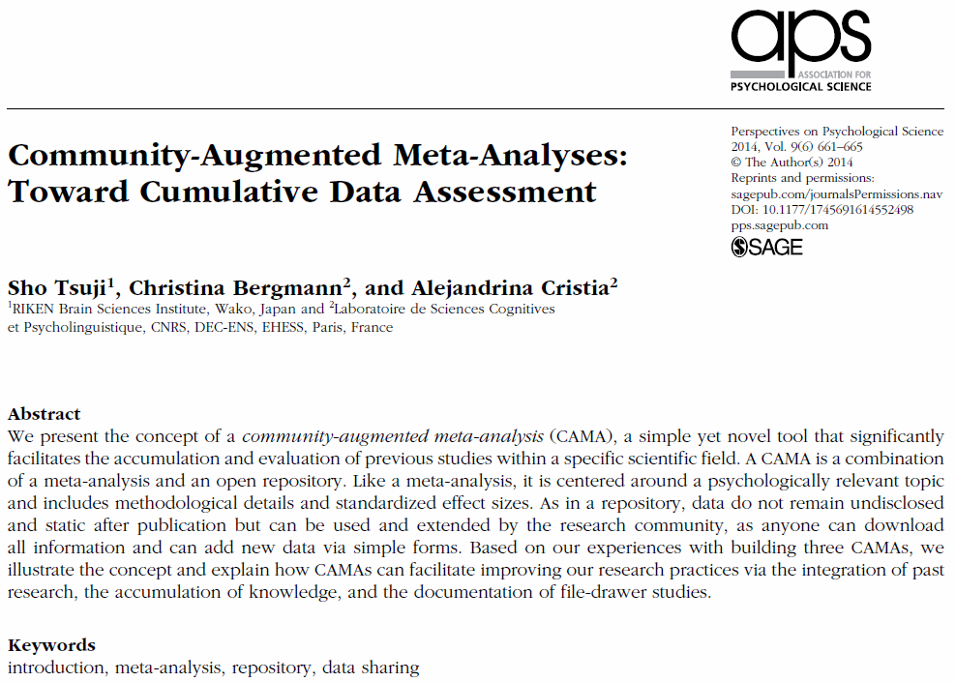
metaBUS
"I have begun to think that no one ought to publish biometric results, without lodging a well-arranged and well-bound copy of his data in some place where it should be accessible, under reasonable restrictions, to those who desire to verify his work.” (Francis Galton, 1901)
John Chambers College of Business and Economics

Slide 68
Open-source meta-analysis tools
metaBUS
An instant meta-analysis tool
See http://metabus.org
Meta-Sen
A comprehensive sensitivity analysis tool
See https://metasen.shinyapps.io/gen1/
John Chambers College of Business and Economics

Slide 69

Current research environment?
John Chambers College of Business and Economics

Slide 70
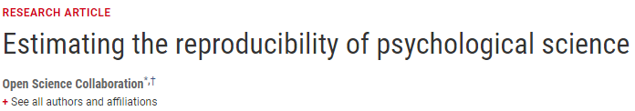


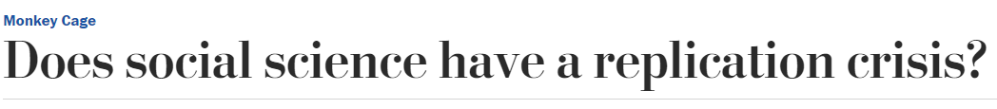
Current research environment?
John Chambers College of Business and Economics

Slide 71
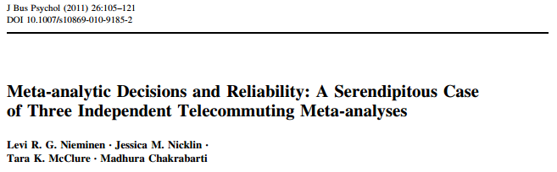
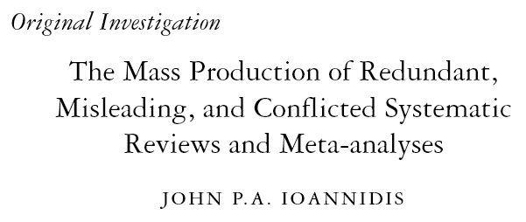

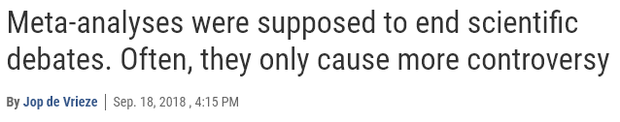
Current (meta) research environment?
John Chambers College of Business and Economics

Slide 72
Current (meta) research environment?
Meta-analysis is not immune from scrutiny
“All the old methods are in doubt. Even meta-analyses, which once were thought to yield a gold standard for evaluating bodies of research now seem somewhat worthless. “Meta-analyses are f**ked,” Inzlicht warned me. If you analyze 200 lousy studies, you’ll get a lousy answer in the end. It’s garbage in, garbage out.” (Engber, March 2016: Slate)
What could be driving opinions like these?
Outliers
Publication bias
John Chambers College of Business and Economics

Slide 73

Meanwhile, I’m here…
John Chambers College of Business and Economics

Slide 74
Current (meta) research environment?
Meta-analysis is not immune from scrutiny
“All the old methods are in doubt. Even meta-analyses, which once were thought to yield a gold standard for evaluating bodies of research now seem somewhat worthless. “Meta-analyses are f**ked,” Inzlicht warned me. If you analyze 200 lousy studies, you’ll get a lousy answer in the end. It’s garbage in, garbage out.” (Engber, March 2016: Slate)
What could be driving opinions like these?
Outliers
Publication bias
John Chambers College of Business and Economics

Slide 75
Current (meta) research environment?
Meta-analysis is not immune from scrutiny
“All the old methods are in doubt. Even meta-analyses, which once were thought to yield a gold standard for evaluating bodies of research now seem somewhat worthless. “Meta-analyses are f**ked,” Inzlicht warned me. If you analyze 200 lousy studies, you’ll get a lousy answer in the end. It’s garbage in, garbage out.” (Engber, March 2016: Slate)
What could be driving opinions like these?
Outliers
Publication bias
John Chambers College of Business and Economics

Slide 76
Live demonstration
Meta-Sen
A comprehensive sensitivity analysis tool
See https://metasen.shinyapps.io/gen1/
John Chambers College of Business and Economics

Slide 77

Thank you for attending today!
Remember…
You can find this presentation and some other meta-analysis resources (e.g., interesting papers) at:
jamiefield.github.io/research/vt2020
John Chambers College of Business and Economics

Slide 78



Questions?
Comments?
Complaints?
Feel free to follow up with me…
james.field2@mail.wvu.edu
@fieldjamie
jamiefield.github.io
John Chambers College of Business and Economics

